Slide 1
Object Detection
Team DetectoVision
Mehedi Hasan, Visaal Nekkanti, Andrew Woska, Abin George
https://github.com/agwoska/DetectoVision

Slide 2
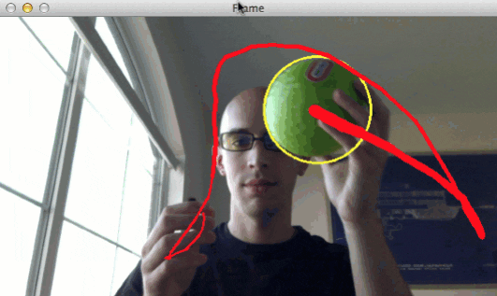
Project Overview
Develop a near real-time detection system to track physical objects using FPGA technology for enhanced image processing.
Features
High-Speed Processing
Low Latency Performance
Advanced Object Tracking
Applications: Robotics, surveillance, automated manufacturing
Notes:
Mehedi
Just repeat skipped slide
Goals: what you are doing and why? With an example

Slide 3
Goals
Project Goals
Camera produces images for the system to analyze
Computer vision algorithm processes image received
Produce a meaningful output that tracks the object’s position
Produce a visual with the modified images
Simulation Goals
Synthesized each module individually
UART recognizes and receives image
CV Algorithms providing meaningful outputs
Visual output for simulated ball X & Y coordinates
Notes:
Mehedi
What do we want our project to accomplish?
What would we consider a successful project?

Slide 4

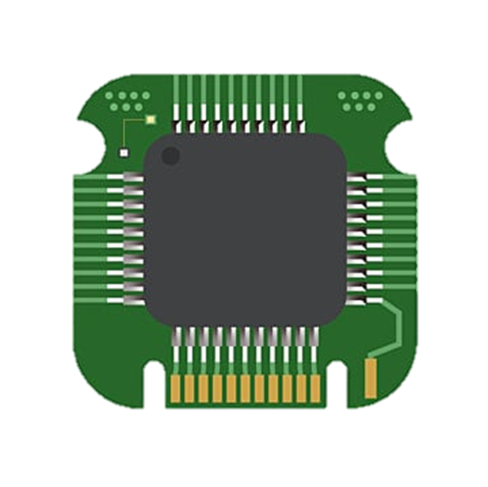

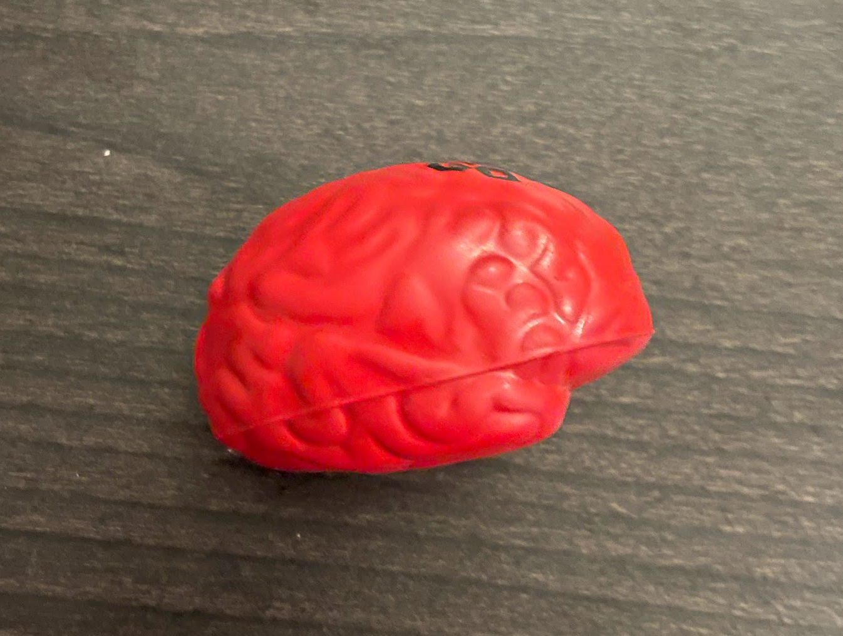
System Overview
Object Image Captured Image Processing Output
Notes:
Mehedi
Similar to the skipped slide
Short functionality- high level overview of the functionality
Very very high level block diagram

Slide 5
System Specifications
Hardware Requirements:
Xilinx Artix 7 FPGA
ESP32-CAM Microcontroller
PC
FPGA Peripherals/Interfaces:
UART
VGA
BRAM
FIFO Register
What are we trying to achieve?
Real time image processing without significant lag.
Whilst, minimizing memory cost and maximizing performance.
Notes:
Mehedi
What are the requirements to complete this project? I.e. FPGA board, camera fps, memory
Include peripherals we used, the constraints we have
What did the design have to do: real time processing thingz.

Slide 6
Ch1: Camera
Andrew
Notes:
Andrew

Slide 7
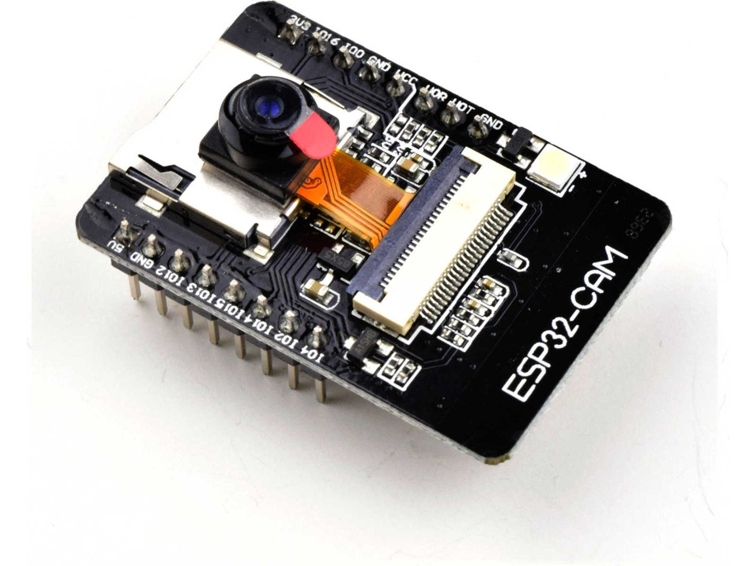
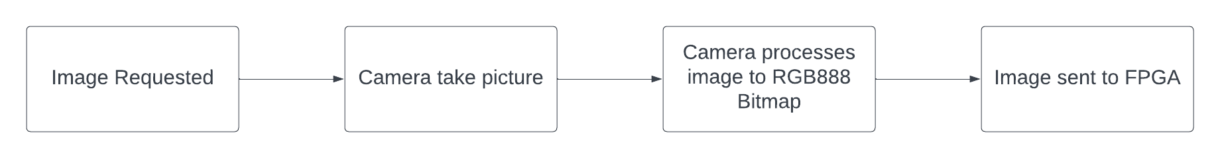
Camera Pipeline
ESP32-CAM with OV2640 2MP camera module
Creates a server instance and initiates UART for communication
PC acts as middleman between camera and FPGA
Notes:
Andrew
ESP32-CAM used to generate necessary images and posts them to its web server. This web server is communicating with the PC which can request new image capture and getting the previous image in system memory.
Image of ESP32-CAM from: https://www.universal-solder.ca/wp-content/uploads/2020/03/2184_5507a683-d21a-4e1b-a165-ac7bec357cb20.jpg

Slide 8
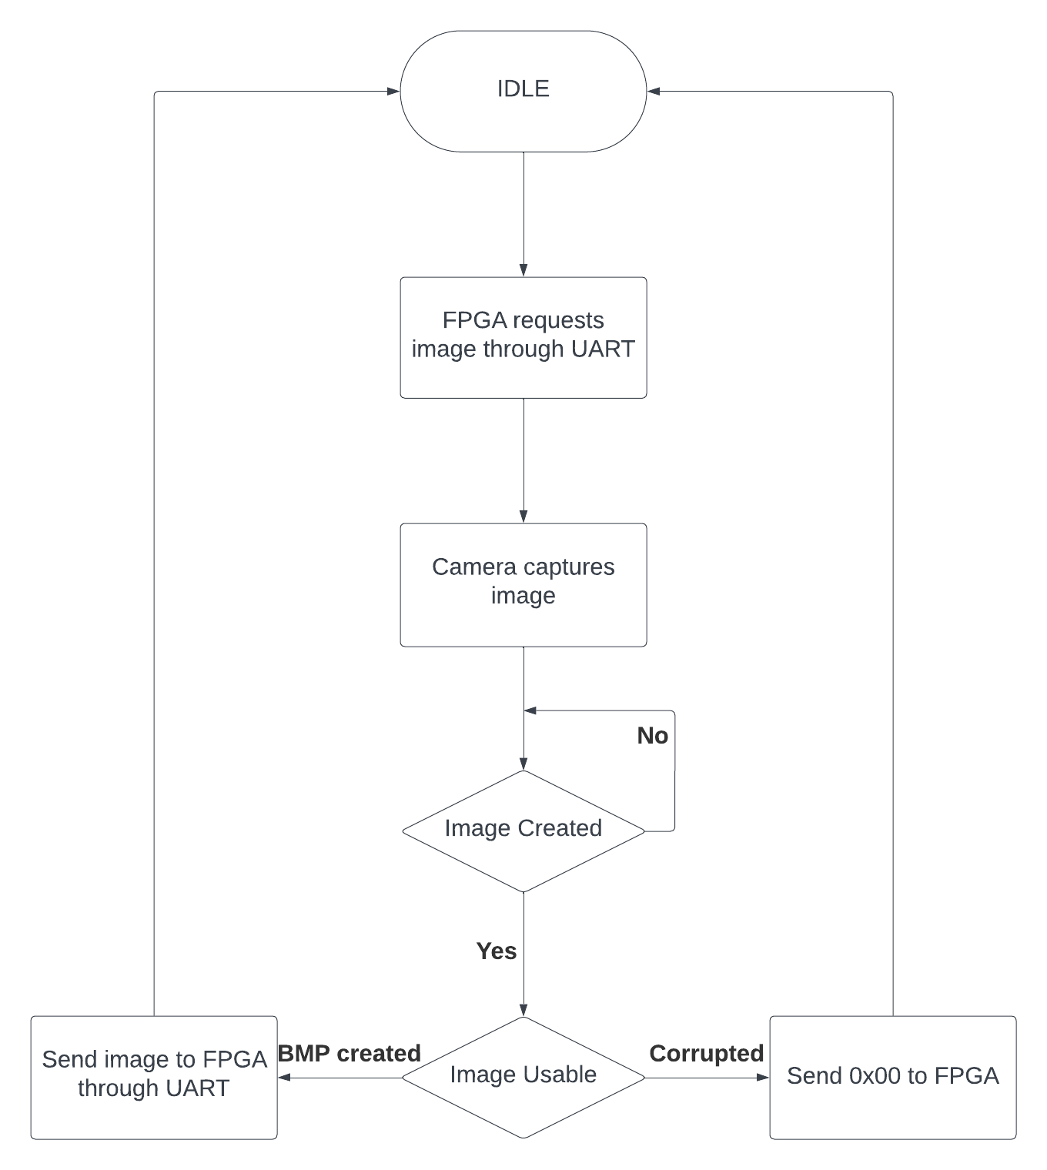

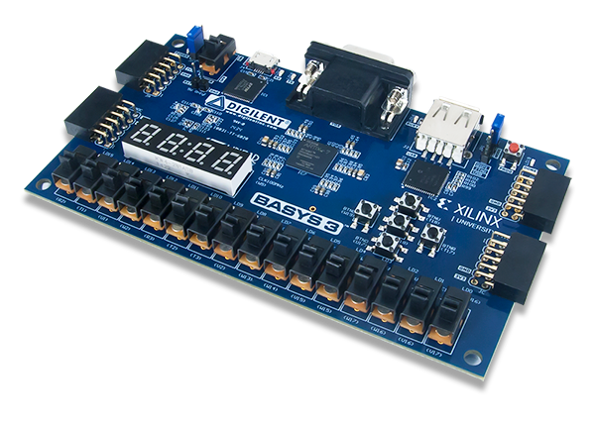

FPGA to ESP32
PC solves problems camera causes
PC provides power and UART communication
Slows potential processing speed
Guarantees usable image
Notes:
Andrew
PC acts as a mediator between the FPGA and the ESP32-CAM. Helps with UART implementation since USB needed for FPGA and ESP32-CAM only has pins.

Slide 9
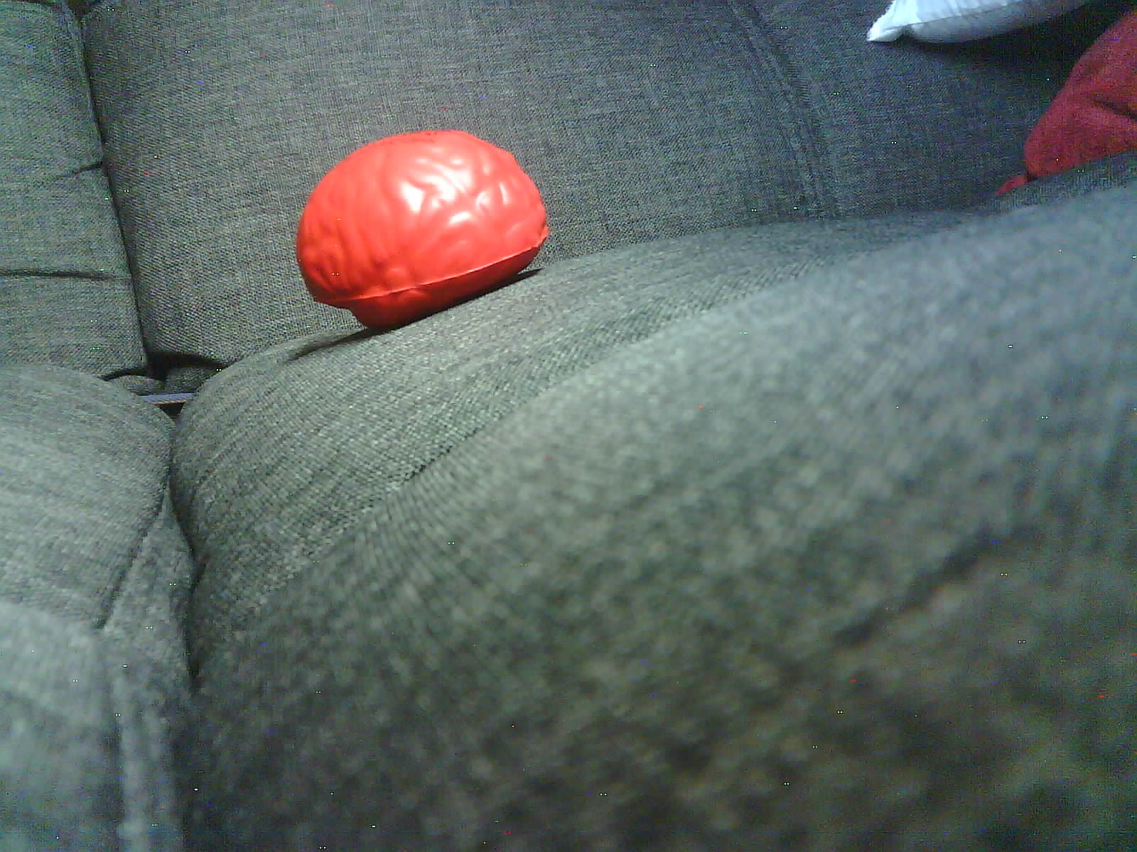
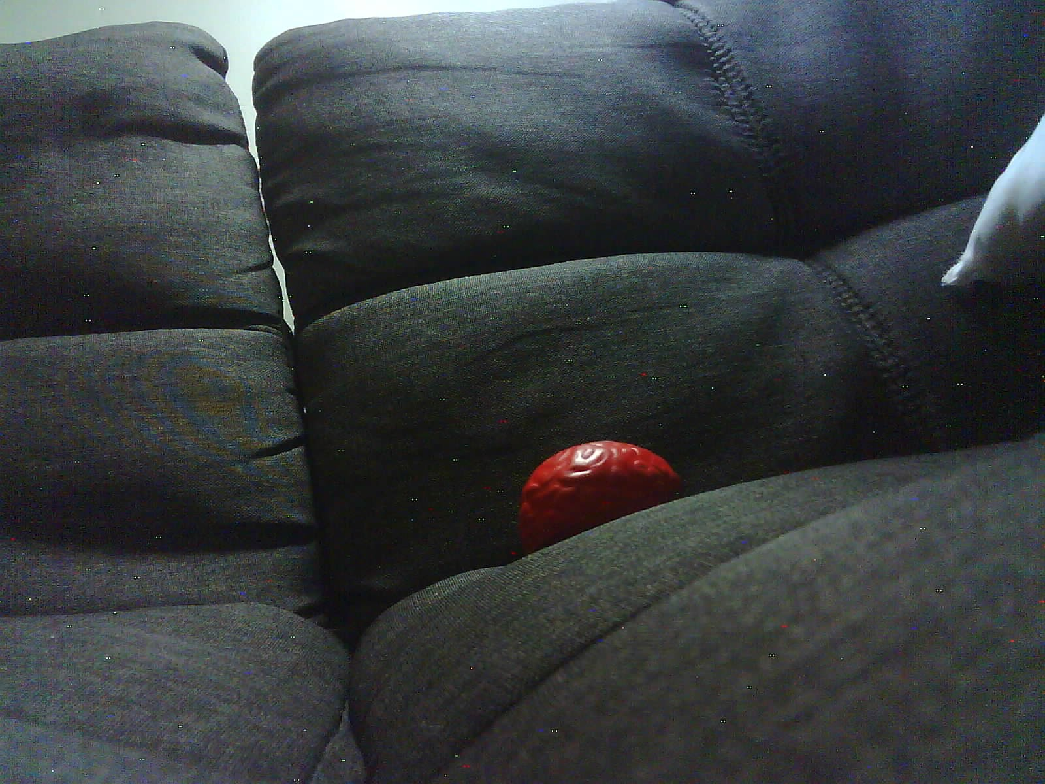
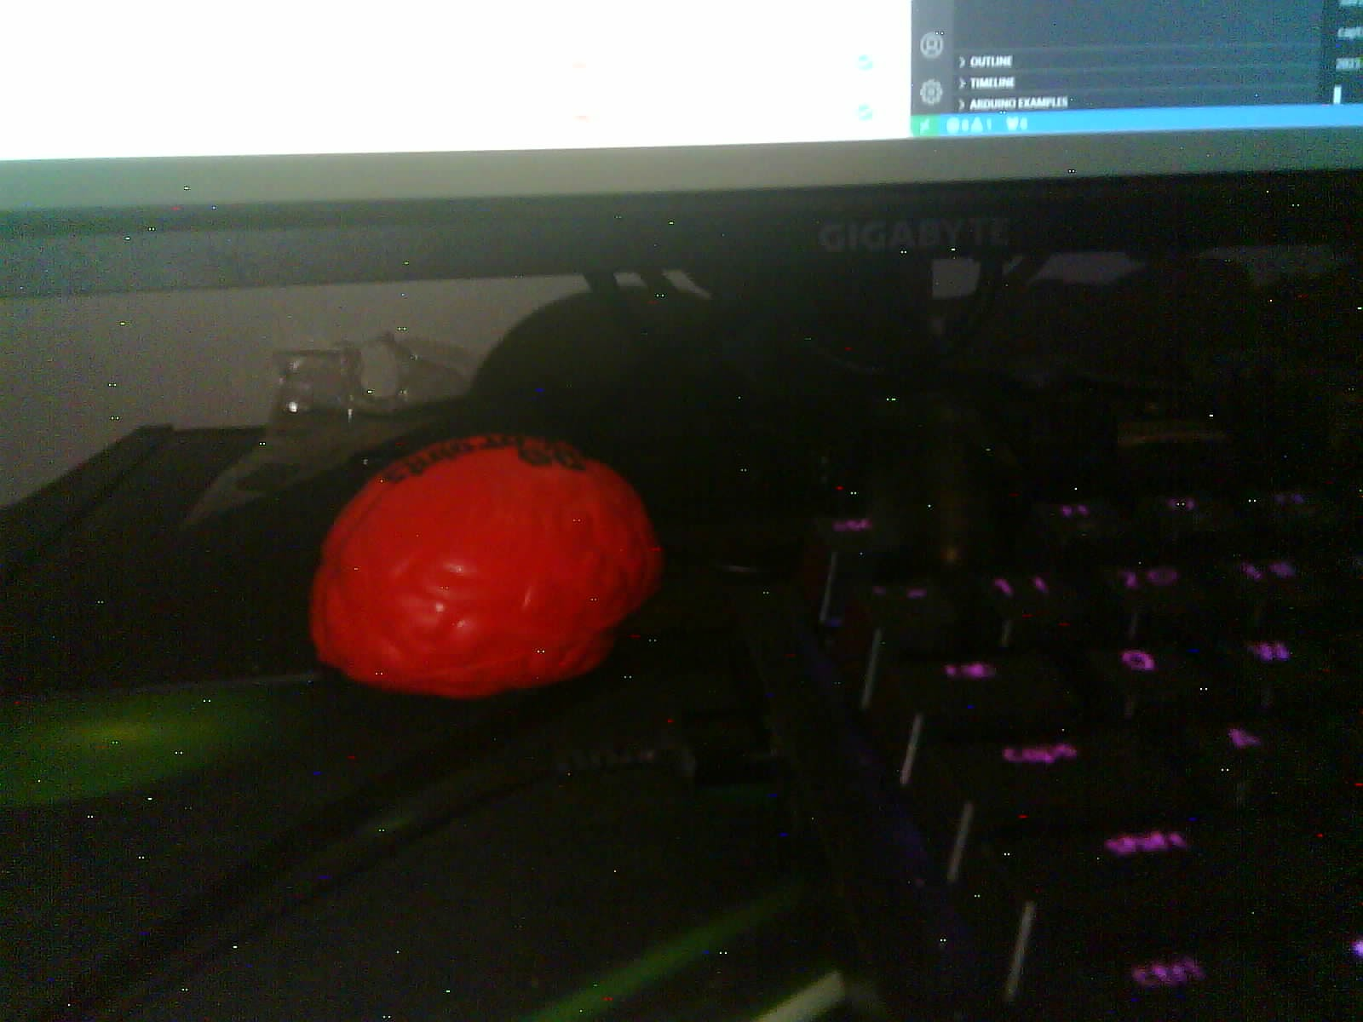
Camera Image
Camera frame size can be 1600x1200 (current), 800x600, or 240x240
Notes:
Andrew
Images taken by my ESP32-CAM notice the static is the later two images. This is likely caused by the conversion from JPEG to BMP since JPEG is lossy

Slide 10
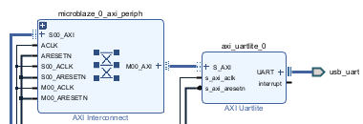
ESP32 to FPGA
Uses Xilinx IP to generate relevant Verilog code with extra module to capture image
module detectovision_wrapper (reset, sys_clock, usb_uart_rxd, usb_uart_txd); input reset; input sys_clock; input usb_uart_rxd; output usb_uart_txd; wire reset; wire sys_clock; wire usb_uart_rxd; wire usb_uart_txd; dv_uart dv_uart_i (.reset(reset), .sys_clock(sys_clock), .usb_uart_rxd(usb_uart_rxd), .usb_uart_txd(usb_uart_txd)); endmodule
Notes:
Andrew
Show us example of your code working. Ideally image or video

Slide 11
Ch2: Image Processing
Abin & Mehedi
Notes:
Abin

Slide 12
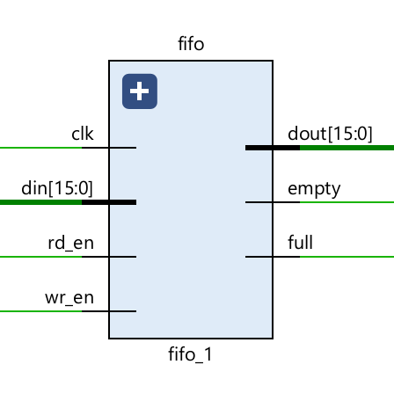
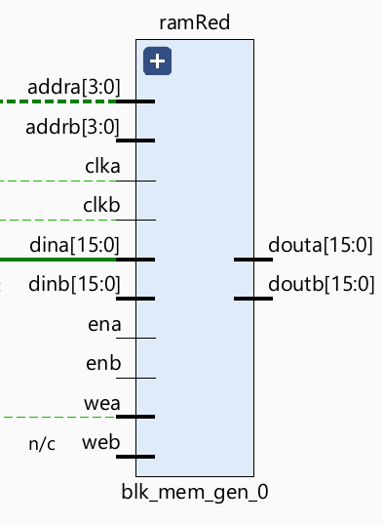
Image Processing Pipeline
Camera*
Grey Scale + Color Masking
FIFO
Buffer (IP)
BRAM 150KB (IP)
VGA*
Hough Transform
Edge Detection
BRAM 150KB (IP)
* Simulation results obtained didn’t use the camera nor the VGA. Instead read and wrote to a bitmap file.
Notes:
Abin

Slide 13
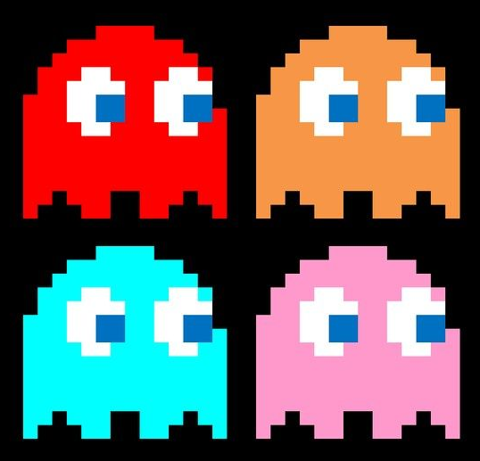
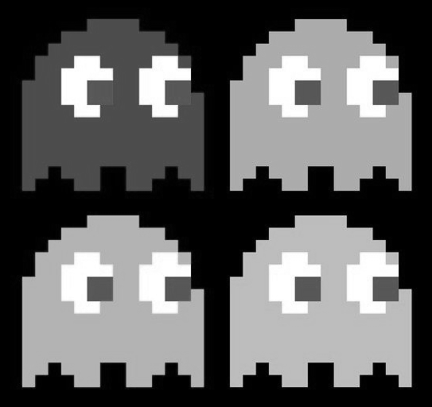
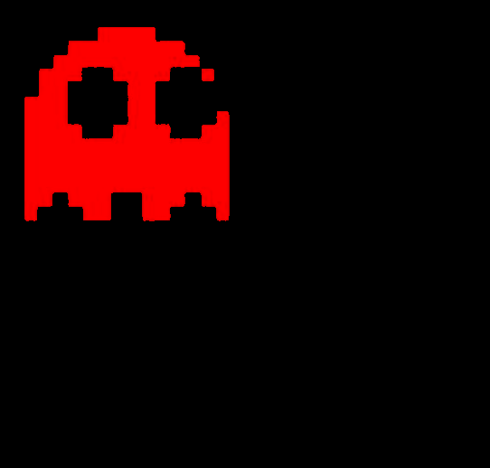
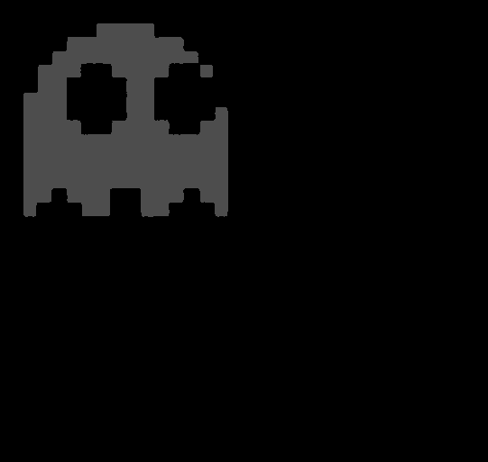
Grey Scale & Color Masking
Camera*
FIFO
Buffer (IP)
Grey Scale + Color Masking
BRAM 150KB (IP)
Edge Detection
BRAM 150KB (IP)
Hough Transform
VGA*
if (R > thresholdMin && G < thresholdMax && B < thresholdMax) outputPixel <= 77; else outputPixel <= 0;
ORIGINAL
GREY SCALING
COLOR MASKING
COLOR MASKING & GREY SCALING
Notes:
Mehidi

Slide 14

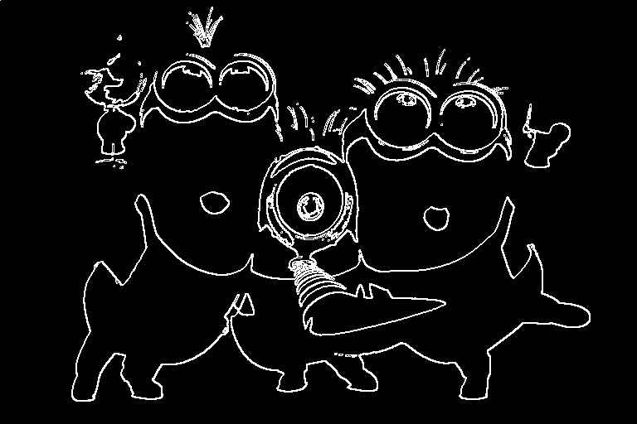
Edge Detection
COULD BE PARALLELIZED TO IMPROVE SPEED !
Camera*
FIFO
Buffer (IP)
Grey Scale + Color Masking
BRAM 150KB (IP)
Edge Detection
BRAM 150KB (IP)
Hough Transform
VGA*
ul | uc | ur
ml | x | mr
dl | dc | dr
ul
.
.
.
*
EDGE THRESHOLD (X)
sorbelFunction edgeDetect (
.CAMERA_CLK(CAMERA_CLK),
.rst(rst),
.ul(ul),
.uc(uc),
.ur(ur),
.ml(ml),
.mc(mc),
.mr(mr),
.dl(dl),
.dc(dc),
.dr(dr),
.outPixel(editedPixel),
.writeBackImage(writeBackImage)
);
uc
+
dr
*
Edge detection at pixel x
Convolution Operator
Notes:
Abin

Slide 15
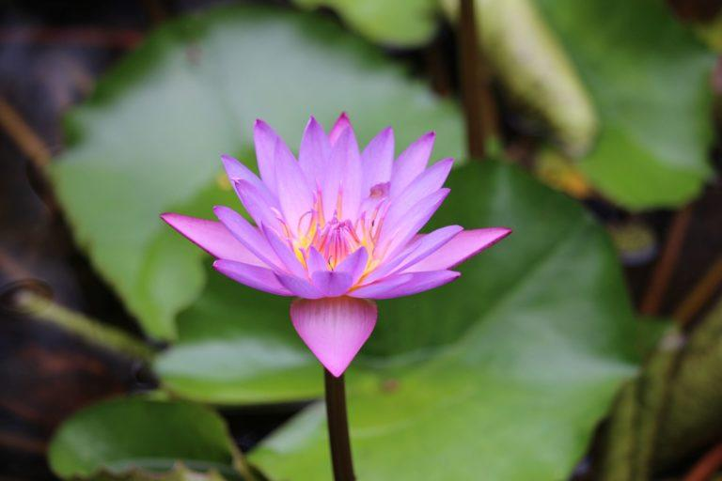
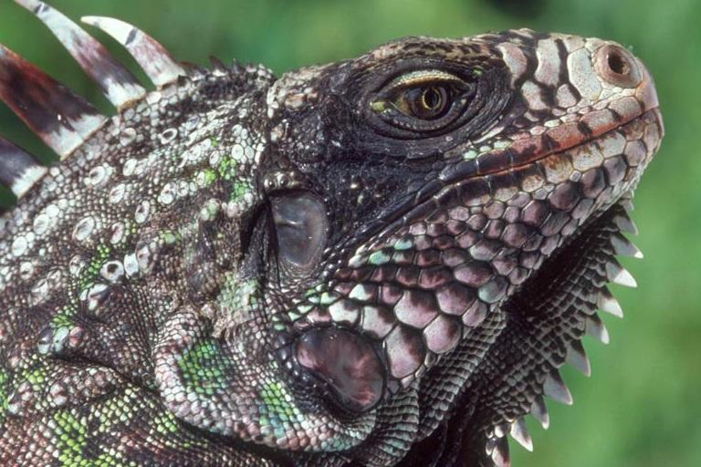
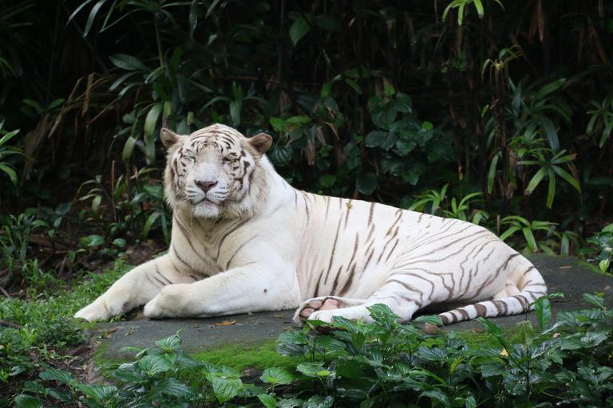
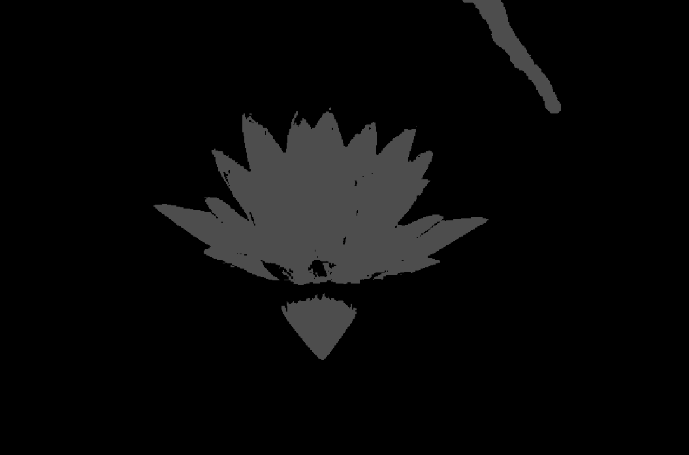
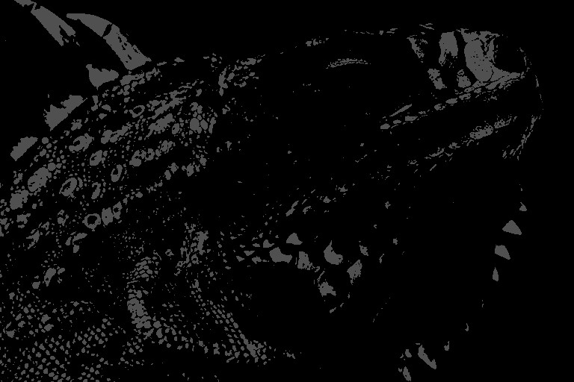
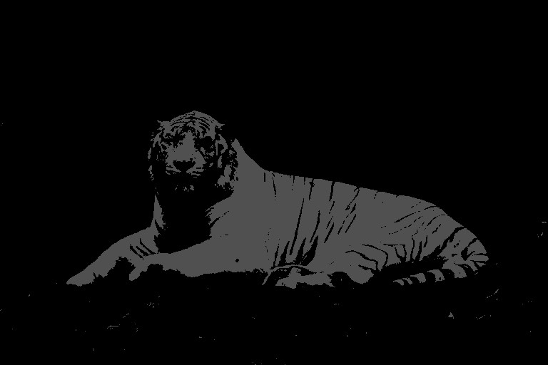
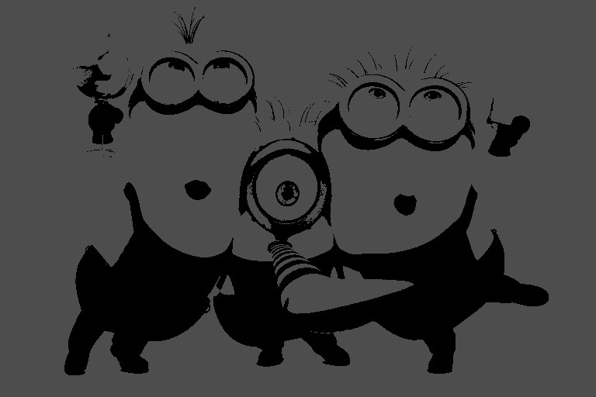
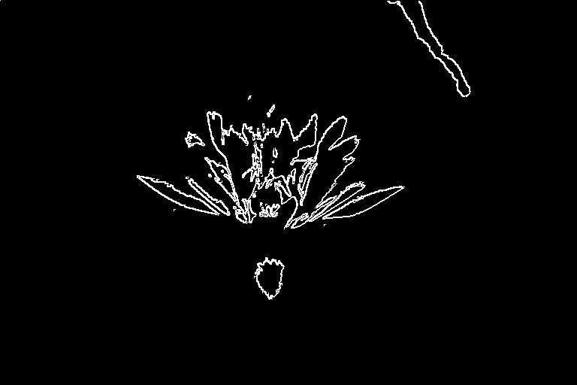
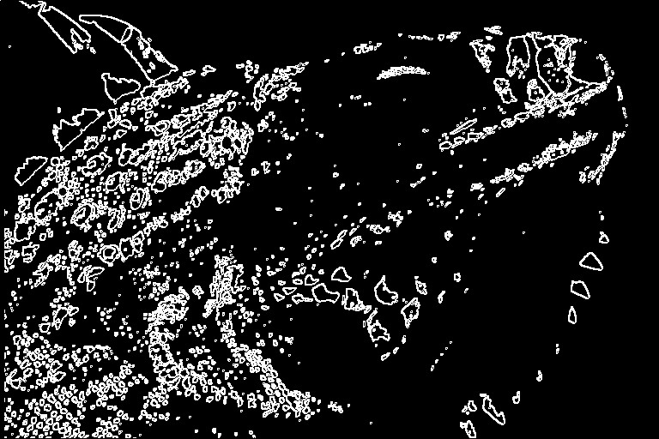
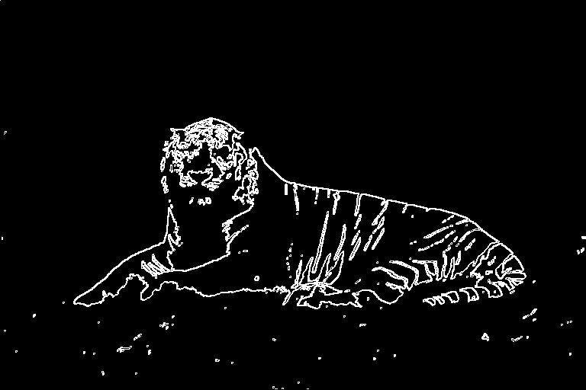
Edge Detection Testbench
Notes:
Abin

Slide 16
Hough Transform
Camera*
FIFO
Buffer (IP)
Grey Scale + Color Masking
BRAM 150KB (IP)
Edge Detection
BRAM 150KB (IP)
Hough Transform
VGA*
Take an edge point from edge detection image.
Notes:
Abin

Slide 17
Hough Transform
Camera*
FIFO
Buffer (IP)
Grey Scale + Color Masking
BRAM 150KB (IP)
Edge Detection
BRAM 150KB (IP)
Hough Transform
VGA*
Take an edge point from edge detection image.
Vote for all pixels with a circle locus of radius r as potential circle center.
Notes:
Abin

Slide 18
Hough Transform
Camera*
FIFO
Buffer (IP)
Grey Scale + Color Masking
BRAM 150KB (IP)
Edge Detection
BRAM 150KB (IP)
Hough Transform
VGA*
Take an edge point from edge detection image.
Vote for all pixels with a circle locus of radius r as potential circle center.
Repeat for other edge points (more points the better).
Notes:
Abin

Slide 19
Hough Transform
Camera*
FIFO
Buffer (IP)
Grey Scale + Color Masking
BRAM 150KB (IP)
Edge Detection
BRAM 150KB (IP)
Hough Transform
VGA*
Take an edge point from edge detection image.
Vote for all pixels with a circle locus of radius r as potential circle center.
Repeat for other edge points (more points the better).
Choose the pixel with the greatest votes.
Notes:
Abin

Slide 20
Hough Transform
Requires voting memory for all the pixels (~ 100KB)
Can we make this more memory efficient?
(Hint: YES)
Camera*
FIFO
Buffer (IP)
Grey Scale + Color Masking
BRAM 150KB (IP)
Edge Detection
BRAM 150KB (IP)
Hough Transform
VGA*
Take an edge point from edge detection image.
Vote for all pixels with a circle locus of radius r as potential circle center.
Repeat for other edge points (more points the better).
Choose the pixel with the greatest votes.
Notes:
Abin

Slide 21

Hough Transform
Requires voting memory for all the pixels (~ 100KB)
Can we make this more memory efficient?
(Hint: YES)
Camera*
FIFO
Buffer (IP)
Grey Scale + Color Masking
BRAM 150KB (IP)
Edge Detection
BRAM 150KB (IP)
Hough Transform
VGA*
Take an edge point from edge detection image.
Vote for all pixels with a circle locus of radius r as potential circle center.
Repeat for other edge points (more points the better).
Choose the pixel with the greatest votes.
Notes:
Abin

Slide 22
Hough Transform (DetectoVision Method)
Camera*
FIFO
Buffer (IP)
Grey Scale + Color Masking
BRAM 150KB (IP)
Edge Detection
BRAM 150KB (IP)
Hough Transform
VGA*
Accumulator: 0
3'b00:
begin nextState_hough <= 3'b001; inY_hough <= inY_hough; inX_hough <= inX_hough + radius; end 3'b01: begin nextState_hough <= 3'b010; inY_hough <= inY_hough; inX_hough <= inX_hough - 2*radius; end 3'b10: begin nextState_hough <= 3'b011; inY_hough <= inY_hough - radius; inX_hough <= inX_hough + radius; end
3'b11: begin nextState_hough <= 3'b100; inY_hough <= inY_hough + 2* radius; inX_hough <= inX_hough; end default: begin nextState_hough <= 3'b000; inY_hough = inY_hough - radius;
FIND NEXT POINT TO TEST AS CENTER
if(last pixel reached)
begin
SEND BEST X AND Y COORD TO VGA
end
end
S0
houghTransform_top circleDetect ( clk, rst, start, edgePix, X, Y, state, idealX, idealY)
Notes:
Abin

Slide 23
Hough Transform (DetectoVision Method)
Camera*
FIFO
Buffer (IP)
Grey Scale + Color Masking
BRAM 150KB (IP)
Edge Detection
BRAM 150KB (IP)
Hough Transform
VGA*
Accumulator: 1
3'b00:
begin nextState_hough <= 3'b001; inY_hough <= inY_hough; inX_hough <= inX_hough + radius; end 3'b01: begin nextState_hough <= 3'b010; inY_hough <= inY_hough; inX_hough <= inX_hough - 2*radius; end 3'b10: begin nextState_hough <= 3'b011; inY_hough <= inY_hough - radius; inX_hough <= inX_hough + radius; end
3'b11: begin nextState_hough <= 3'b100; inY_hough <= inY_hough + 2* radius; inX_hough <= inX_hough; end default: begin nextState_hough <= 3'b000; inY_hough = inY_hough - radius;
FIND NEXT POINT TO TEST AS CENTER
if(last pixel reached)
begin
SEND BEST X AND Y COORD TO VGA
end
end
S0
S1
houghTransform_top circleDetect ( clk, rst, start, edgePix, X, Y, state, idealX, idealY)
Notes:
Abin

Slide 24
Hough Transform (DetectoVision Method)
Camera*
FIFO
Buffer (IP)
Grey Scale + Color Masking
BRAM 150KB (IP)
Edge Detection
BRAM 150KB (IP)
Hough Transform
VGA*
Accumulator: 2
3'b00:
begin nextState_hough <= 3'b001; inY_hough <= inY_hough; inX_hough <= inX_hough + radius; end 3'b01: begin nextState_hough <= 3'b010; inY_hough <= inY_hough; inX_hough <= inX_hough - 2*radius; end 3'b10: begin nextState_hough <= 3'b011; inY_hough <= inY_hough - radius; inX_hough <= inX_hough + radius; end
3'b11: begin nextState_hough <= 3'b100; inY_hough <= inY_hough + 2* radius; inX_hough <= inX_hough; end default: begin nextState_hough <= 3'b000; inY_hough = inY_hough - radius;
FIND NEXT POINT TO TEST AS CENTER
if(last pixel reached)
begin
SEND BEST X AND Y COORD TO VGA
end
end
S2
S0
S1
houghTransform_top circleDetect ( clk, rst, start, edgePix, X, Y, state, idealX, idealY)
Notes:
Abin

Slide 25
Hough Transform (DetectoVision Method)
Camera*
FIFO
Buffer (IP)
Grey Scale + Color Masking
BRAM 150KB (IP)
Edge Detection
BRAM 150KB (IP)
Hough Transform
VGA*
Accumulator: 3
3'b00:
begin nextState_hough <= 3'b001; inY_hough <= inY_hough; inX_hough <= inX_hough + radius; end 3'b01: begin nextState_hough <= 3'b010; inY_hough <= inY_hough; inX_hough <= inX_hough - 2*radius; end 3'b10: begin nextState_hough <= 3'b011; inY_hough <= inY_hough - radius; inX_hough <= inX_hough + radius; end
3'b11: begin nextState_hough <= 3'b100; inY_hough <= inY_hough + 2* radius; inX_hough <= inX_hough; end default: begin nextState_hough <= 3'b000; inY_hough = inY_hough - radius;
FIND NEXT POINT TO TEST AS CENTER
if(last pixel reached)
begin
SEND BEST X AND Y COORD TO VGA
end
end
S2
S0
S1
S3
houghTransform_top circleDetect ( clk, rst, start, edgePix, X, Y, state, idealX, idealY)
Notes:
Abin

Slide 26
Hough Transform (DetectoVision Method)
Camera*
FIFO
Buffer (IP)
Grey Scale + Color Masking
BRAM 150KB (IP)
Edge Detection
BRAM 150KB (IP)
Hough Transform
VGA*
Accumulator: 4
3'b00:
begin nextState_hough <= 3'b001; inY_hough <= inY_hough; inX_hough <= inX_hough + radius; end 3'b01: begin nextState_hough <= 3'b010; inY_hough <= inY_hough; inX_hough <= inX_hough - 2*radius; end 3'b10: begin nextState_hough <= 3'b011; inY_hough <= inY_hough - radius; inX_hough <= inX_hough + radius; end
3'b11: begin nextState_hough <= 3'b100; inY_hough <= inY_hough + 2* radius; inX_hough <= inX_hough; end default: begin nextState_hough <= 3'b000; inY_hough = inY_hough - radius;
FIND NEXT POINT TO TEST AS CENTER
if(last pixel reached)
begin
SEND BEST X AND Y COORD TO VGA
end
end
S4
S2
S0
S1
S3
houghTransform_top circleDetect ( clk, rst, start, edgePix, X, Y, state, idealX, idealY)
Notes:
Abin

Slide 27
Hough Transform (DetectoVision Method)
Camera*
FIFO
Buffer (IP)
Grey Scale + Color Masking
BRAM 150KB (IP)
Edge Detection
BRAM 150KB (IP)
Hough Transform
VGA*
Accumulator: 0
3'b00:
begin nextState_hough <= 3'b001; inY_hough <= inY_hough; inX_hough <= inX_hough + radius; end 3'b01: begin nextState_hough <= 3'b010; inY_hough <= inY_hough; inX_hough <= inX_hough - 2*radius; end 3'b10: begin nextState_hough <= 3'b011; inY_hough <= inY_hough - radius; inX_hough <= inX_hough + radius; end
3'b11: begin nextState_hough <= 3'b100; inY_hough <= inY_hough + 2* radius; inX_hough <= inX_hough; end default: begin nextState_hough <= 3'b000; inY_hough = inY_hough - radius;
FIND NEXT POINT TO TEST AS CENTER
if(last pixel reached)
begin
SEND BEST X AND Y COORD TO VGA
end
end
S0
houghTransform_top circleDetect ( clk, rst, start, edgePix, X, Y, state, idealX, idealY)
Notes:
Abin

Slide 28
Hough Transform (DetectoVision Method)
Camera*
FIFO
Buffer (IP)
Grey Scale + Color Masking
BRAM 150KB (IP)
Edge Detection
BRAM 150KB (IP)
Hough Transform
VGA*
Accumulator: 0
3'b00:
begin nextState_hough <= 3'b001; inY_hough <= inY_hough; inX_hough <= inX_hough + radius; end 3'b01: begin nextState_hough <= 3'b010; inY_hough <= inY_hough; inX_hough <= inX_hough - 2*radius; end 3'b10: begin nextState_hough <= 3'b011; inY_hough <= inY_hough - radius; inX_hough <= inX_hough + radius; end
3'b11: begin nextState_hough <= 3'b100; inY_hough <= inY_hough + 2* radius; inX_hough <= inX_hough; end default: begin nextState_hough <= 3'b000; inY_hough = inY_hough - radius;
FIND NEXT POINT TO TEST AS CENTER
if(last pixel reached)
begin
SEND BEST X AND Y COORD TO VGA
end
end
Needs memory for the following values:
Best X,Y coordinates
Highest accumulator value
Current accumulator value
NEW MEMORY REQ: 4 bytes.
S0
houghTransform_top circleDetect ( clk, rst, start, edgePix, X, Y, state, idealX, idealY)
Notes:
Abin

Slide 29
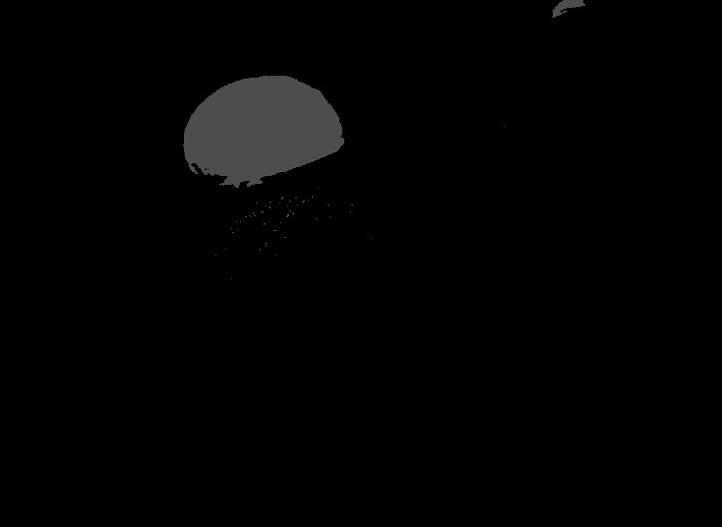
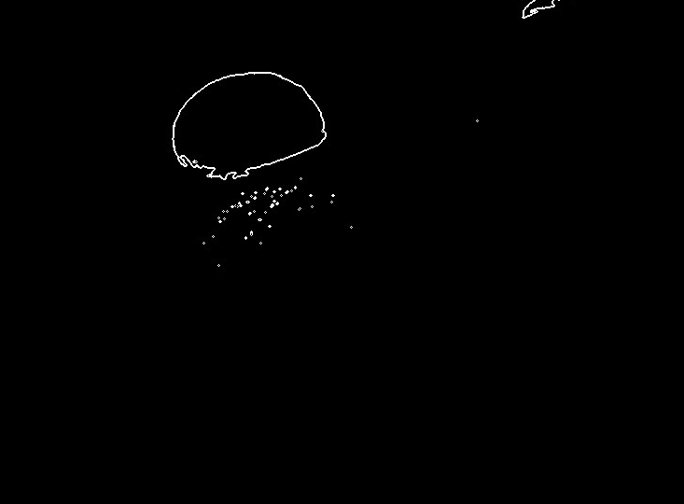
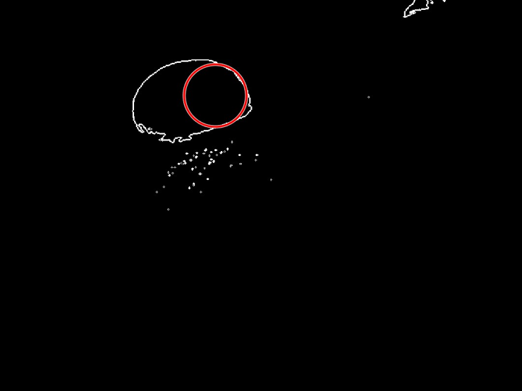
Everything Together (Sim results)
CAMERA
X = 133
Y = 308
GREY SCALE + COLOR MASK
EDGE DETECTION
OBJECT DETECTION
Notes:
Abin

Slide 30
Ch3: Visual Output
Visaal
Notes:
Visaal

Slide 31
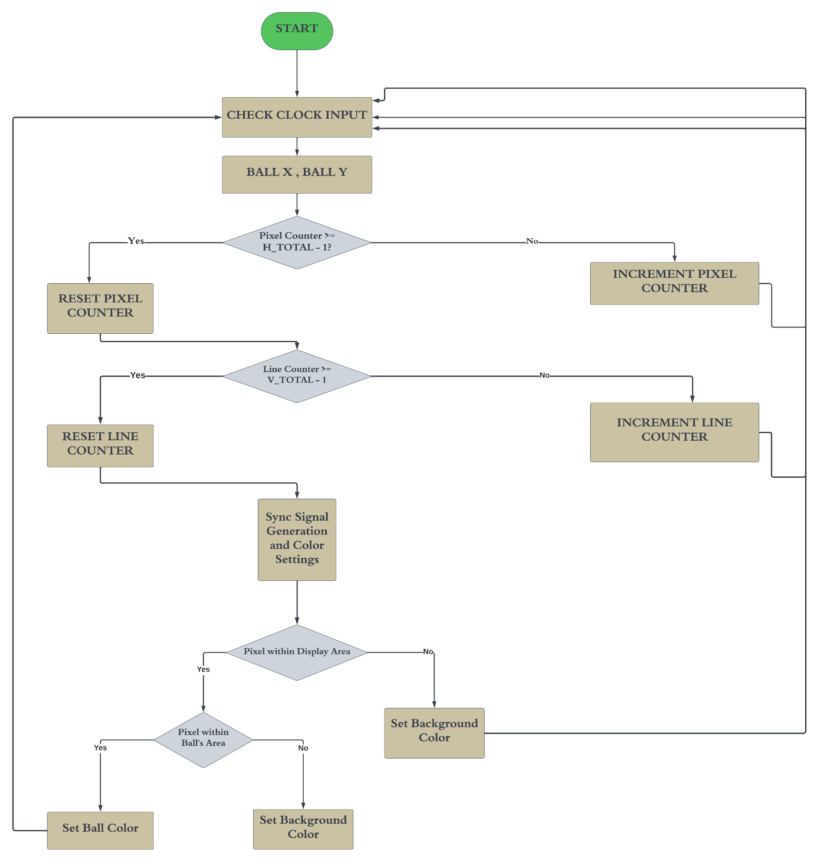
Flowchart
Notes:
Visaal

Slide 32
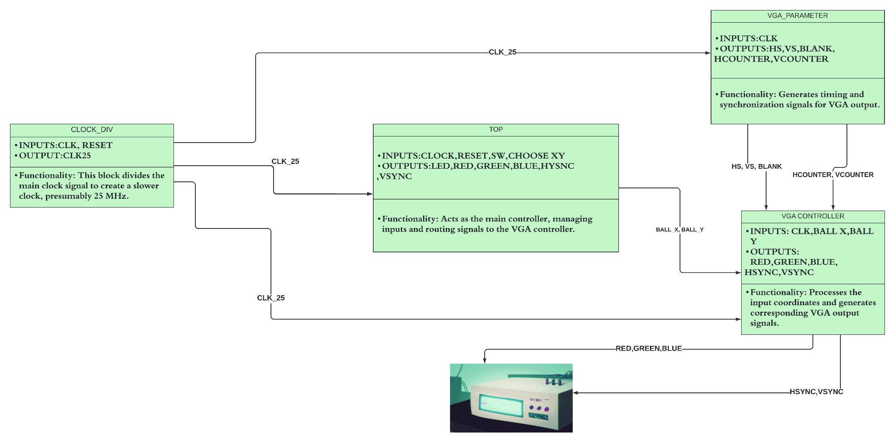
BLOCK DIAGRAM: WORKING AND CONNECTIONS
Notes:
Visaal

Slide 33
VISUAL OUTPUT
always @(*) begin if (vga_blank | ~inBounds) begin red = 0; green = 0; blue = 0; end else begin if (ballDetections) begin red <= 4'h0; green <= 4'h0; blue <= 4'hF; end else begin red <= 15; green <= 15; blue <= 15; end end end
Blanking and Bounds Check: The condition if (vga_blank | ~inBounds) checks whether the current pixel is in a blanking interval (vga_blank) or outside the displayable area of the VGA screen (~inBounds).
Ball Detection: The variable ballDetections is used to determine if the current pixel lies within the coordinates of the ball (ball_x, ball_y).
Background Color: If the current pixel is not part of the ball (else part of if (ballDetections)), the RGB values are set to maximum (15), which typically represents white color.
Notes:
Visaal

Slide 34
VISUAL OUTPUT
always@(posedge pixel_clk)begin if (hcounter == HMAX) hcounter <= 0; else hcounter <= hcounter + 1; end always@(posedge pixel_clk)begin if(hcounter == HMAX) begin if(vcounter == VMAX) vcounter <= 0; else vcounter <= vcounter + 1; end end always@(posedge pixel_clk)begin if(hcounter >= HFP && hcounter < HSP) HS <= SPP; else HS <= ~SPP; end always@(posedge pixel_clk)begin if(vcounter >= VFP && vcounter < VSP) VS <= SPP; else VS <= ~SPP; end
Horizontal Counter (hcounter): Incremented with each positive edge of pixel_clk.Resets to 0 when it reaches the maximum horizontal count (HMAX), which signifies the end of a scan line.
Horizontal Sync Signal (HS): Generated based on the value of hcounter.HS is set to SPP (Sync Pulse Polarity- 1) when hcounter is within the horizontal sync pulse region (between HFP - front porch end, and HSP - sync pulse end).Otherwise, HS is set to the inverse of SPP(ZERO).
Vertical Counter (vcounter): Incremented when hcounter resets (i.e., at the end of each horizontal scan line).Resets to 0 when it reaches the maximum vertical count (VMAX), indicating the completion of a frame (all scan lines).
Vertical Sync Signal (VS): Generated based on the value of vcounter.It's set to SPP when vcounter is in the vertical sync pulse region (between VFP and VSP).Otherwise this region, VS is set to the inverse of SPP.
Notes:
Visaal

Slide 35
Functionality Detailed
Check Clock Input: Checks for the positive edge of the clock signal.
Process Inputs (ball_x, ball_y): Processes the inputs ball_x and ball_y, which represent the coordinates of the ball on the screen. These coordinates are used to determine where to draw the ball in the VGA display.
Pixel Counter Check ("Pixel Counter >= H_TOTAL - 1?"): Checks if the horizontal pixel counter has reached its limit (H_TOTAL - 1). This is essential for determining when to move to the next line on the VGA display.
Reset Pixel Counter: Resets the horizontal pixel counter to 0. This occurs at the end of each line of pixels, preparing the controller to start the next line.
Increment Pixel Counter: Increments the horizontal pixel counter by 1. This is done for each clock cycle until the end of the line is reached.
Line Counter Check ("Line Counter >= V_TOTAL - 1?"): Checks if the vertical line counter has reached its limit (V_TOTAL - 1). This helps determine when the VGA display has completed one frame and needs to start a new frame.
Reset Line Counter: Resets the vertical line counter to 0. This is performed at the end of each frame, resetting the display to start drawing from the top again.
Increment Line Counter: Increments the vertical line counter by 1, moving down to the next line in the VGA frame. This occurs at the end of each horizontal line.
Generate Sync Signals: Generates the horizontal sync (hsync) and vertical sync (vsync) signals. These signals are used to synchronize the display with the VGA controller, indicating when a line or a frame ends.
Display Area Check ("Pixel within Display Area?"): Determines whether the current pixel position is within the active display area (the area where the image is actually drawn).
Ball Position Check ("Pixel within Ball's Area?"): Checks if the current pixel falls within the coordinates of the ball. This determines whether to color the pixel as part of the ball or as part of the background.
Set Ball Color: If the current pixel is within the ball's area, this block sets the RGB values to display the ball's color.
Set Background Color: If the current pixel is not within the ball's area, this block sets the RGB values to display the background color.

Slide 36
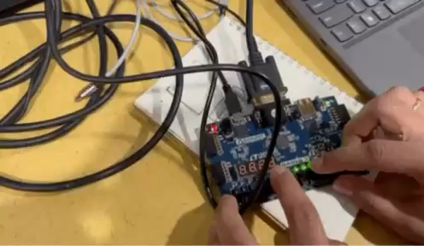
Simulation result
LINK
Notes:
Visaal

Slide 37
Tradeoffs
Memory Capacity: Using Basys 3 over Nexys 7 results in reduced memory capacity
Camera Integration: ESP32-CAM is a combined microcontroller and camera, unlike standalone cameras
Camera Resolution: ESP32-CAM offers higher and adjustable resolution unlike cameras connected directly to the FPGA board
FPS: frame rate affected by conversions from the PC and camera
Image Format: using BMP instead of JPEG simplifies processing requirements but requires conversion
Performance: does not fully utilize FPGAs speed capabilities by creating bottlenecks
Notes:
Andrew
Tradeoffs memory, camera, reduce clock speed, resolution, fps (possibly?)
Basys 3 vs Nexus 7
Speed vs Memory
Camera
Original image information is lost

Slide 38
Successes
- ESP32-CAM creates viewable images that can interact with other devices
- Image can be transferred to other devices
- The camera works
Successfully implemented the necessary steps to detect an object:
- Image masking
- Grey scaling
- Edge detection
- Object detection
- VGA script that can display the position of ball using a marker given only the X and Y coordinates.
- Simulated and synthesized onto a FPGA to test and verify the functionality of the module.
Notes:
Visaal
Have 3 columns for each module

Slide 39
Failures
Original camera OV7670 could not be configured to work or was DOA
ESP32-CAM has trouble supporting JPEG to RGB888 conversions on-board
Camera produces RGB static
Creates system bottleneck
- Could improve performance by increasing # of threads:
- Ex: have non-dependent blocks of image run in parallel.
- More efficient use of memory:
- Ex: might be smarter to store only the necessary sections of the image.
Notes:
Visaal
Have 3 columns for each module

Slide 40
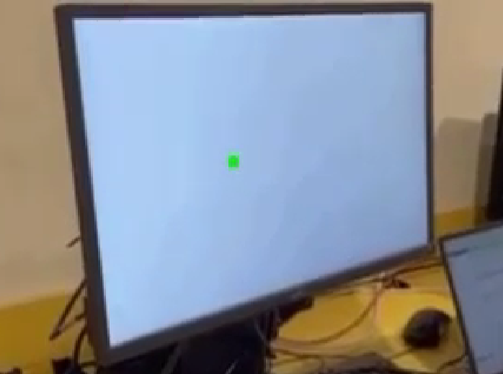
Where are we now?
Notes:
Abin

Slide 41
What is next?
Notes:
Abin

Slide 42

Questions?
https://github.com/agwoska/DetectoVision
Notes:
Abin

Slide 43
Ch4: Backup Slides
Notes:
Visaal

Slide 44
Original Testbench Images
Notes:
Visaal

Slide 45
Grey Scale and Color Mask
Notes:
Visaal

Slide 46
Edge detection
Notes:
Visaal

Slide 47
Our Example
Notes:
Visaal

